Slide 1

Bonam Venkata Chalamayya Engineering College (Autonomous)
REALIZATION OF QUANTUM FAULT TOLERANT ADDER FULL ADDER CIRCUIT
DEPARTMENT OF ELECTRONICS AND COMMUNICATION ENGINEERING
Project Associates(Batch No. C 12)
K. Sainadh (20225A0410)
A. Ayyappa (20225A0419)
T. Sai Deep (19221A04G1)
V. Mahesh (19221A04H1)
Under the Esteemed Guidance Of
Mrs. V. SANDHYA, M. Tech
Associate Professor

Slide 2
CONTENTS
Abstract
Introduction to Quantum Computing
Classical Vs Quantum Computing
Working of Quantum Computing
Classical Gates and Quantum Gates
Types of Quantum Gates
Fault tolerance
Islam Gates
Full Adder Circuit Using Reversible Gate
Proposed Fault Tolerance Circuit
Software Requirements
Implementation
Application & Advantages
Conclusion
Future Scope

Slide 3
ABSTRACT
Quantum Computing is Fundamentally very different from the classical computing on the basis of processing it information. Now Since it is an extremely new concept or if I may put it as futuristic concept, we deal with a lot of errors while managing it. Our project proposes to build a Quantum Fault Tolerant Full Adder Circuit. Fault Tolerant helps a system to work normally in the event of failure. We used a 4*4 parity preserving logic gate named Islam Gate & a designed combination if the 2IG’s will result in a FTFA circuit as proposed.

Slide 4
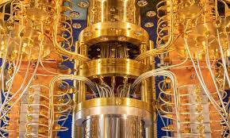
INTRODUCTION TO QUANTUM COMPUTING
There is a huge development in the generation of technology. With the help of artificial intelligence computers and robots have excelled in the field of health, weapon and so much more.
The quantum computers are totally different from traditional
computers, they are basically future computers which would
slowly be a part of our everyday life and make huge impacts on it.
It can solve complex problems in few minutes which is impossible
to do with our normal computers. The quantum computers therefore
are more powerful and futuristic.
It is assumed that the speed of a 40 qubit quantum computer is equivalent to the speed of today’s super computer.

Slide 5

WORKING OF QUANTUM COMPUTERS
In the place of computer chip the quantum computer uses atoms for its calculations.
Scientists came across the idea of quantum computer when they understood that atoms is a type of complex calculator.
The atoms that spins either goes up or down which resembles
a lot to digital technology where every data is represented at 0 or 1.
But actually when an atom spins, the length of spin can be
both upward and downward similarly quantum computers can hold the value of 0 and 1 at the same time

Slide 6
QUANTUM vs CLASSICAL COMPUTING
Basic Difference
Classical Computers | Quantum Computers
We use binary digits or bit which has two values 0 or 1, our computers understands only these bits and functions accordingly, computer circuits have transistors which recognises these bits and converts it into electrical signals and sends data to several parts at a time only one among the following is used. | Instead of binary digits quantum digits are used they are called qubits. Unlike Common computers which can at one time have only 2 values, either 0 or 1, In quantum computer at a time the qubit value can be more than 0 and 1. It can hold 4 values at a time. This makes it different and fastens the speed.

Slide 7
CLASSICAL GATES AND QUANTUM GATES
Just like classical gates are the building blocks of classical computers, quantum gates are the basic building blocks of quantum computer.
The gates used for a classical computation implements binary operations on binary inputs, changing zeroes into ones and vice versa.
For example, the only nontrivial single bit logic operation is NOT, which takes 0 to 1 and 1 to 0.
In a quantum computation the situation is quite different, because qubits can exist in superposition of 0 and 1. The set of allowable single qubit operations consists of unitary transformations corresponding to 2 × 2 complex matrices U such that U†U = 1.
Unlike classical gates the quantum logic gates are reversible gates.

Slide 8
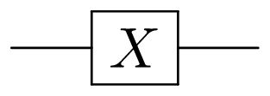
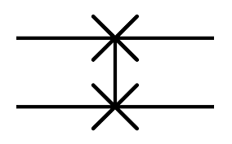
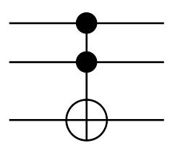
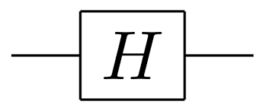
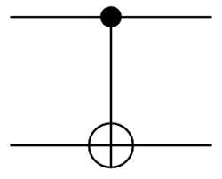
TYPES OF QUANTUM GATES
Swap Gate
Pauli’s X Gate
Toffoli Gate
Cnot Gate
Hadam-ard Gate

Slide 9
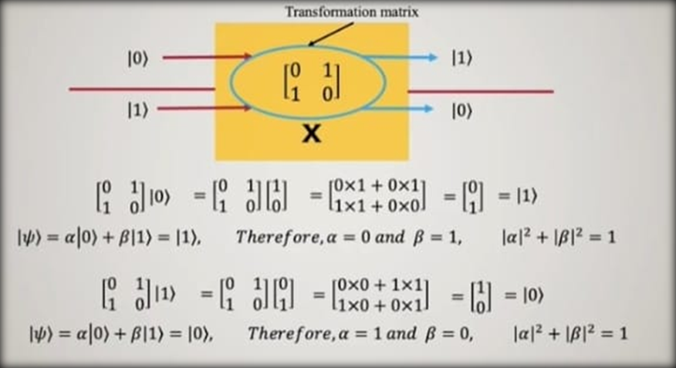
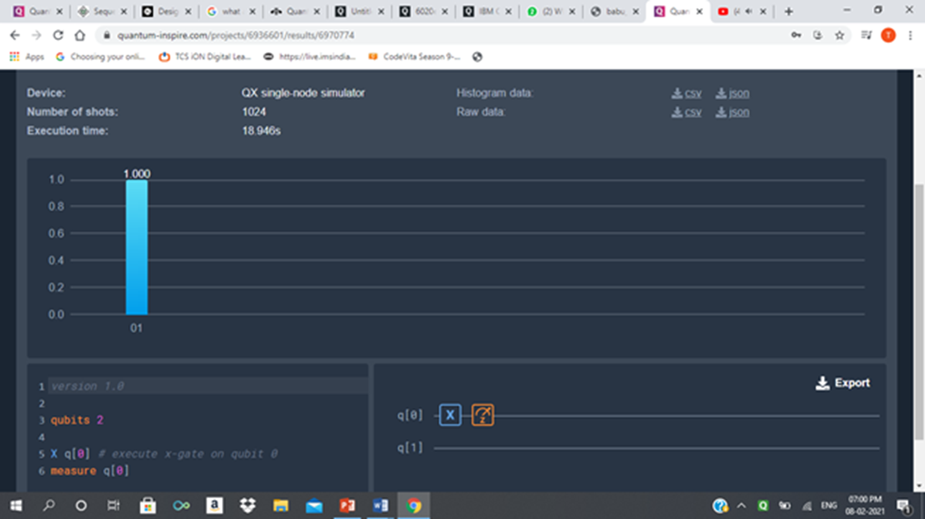
PAULI-X GATE
Pauli-X gate= NOT gate i.e. when we give |0⟩ as input we get output as |1⟩ Whereas, when we give |1⟩ as input after operation we get |0⟩ as output.

Slide 10
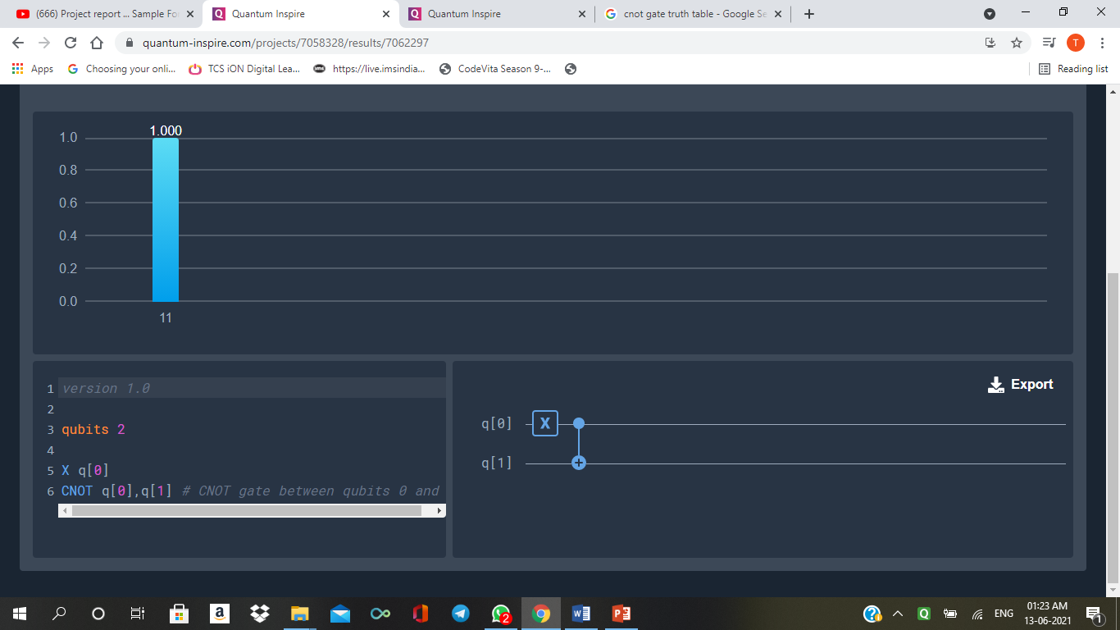
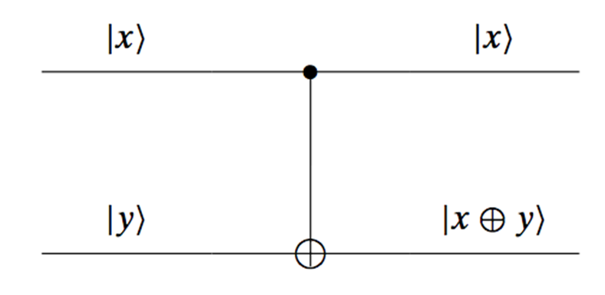
CONTROLLED-NOT GATE
If control bit and target bit are |0⟩ and |1⟩ or |0⟩ and |0⟩ respectively then there is no change in the output target bit.
In case of |1⟩ and |0⟩ or |1⟩ and |1⟩ in control bit and target bit the output target bit reverses.

Slide 11
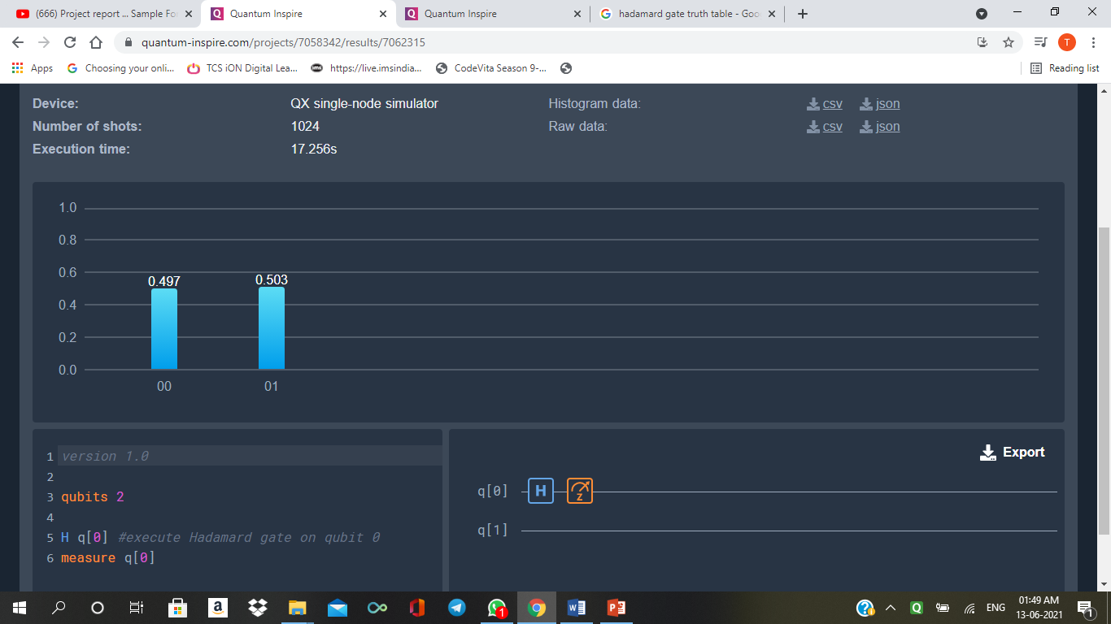
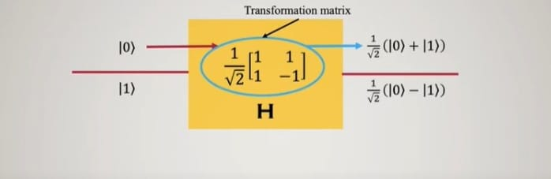
HADAMARD GATE
It is a single qubit quantum gate.
2 consecutive Hadamard operation is an identity matrix.
The gate creates superposition of two states i.e. when I/P is ket 0 then O/P becomes |0⟩ + |1⟩by√2.
Similarly when Hadamard operation is applied on ket 1 then O/P becomes |0⟩ – |1⟩ by√ 2.

Slide 12
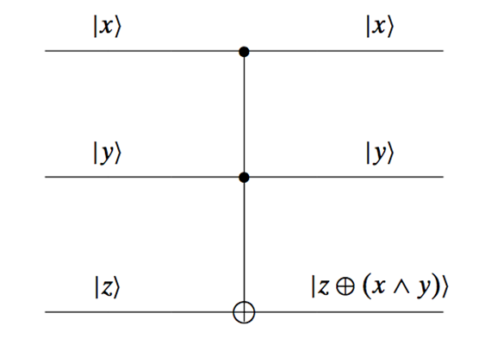
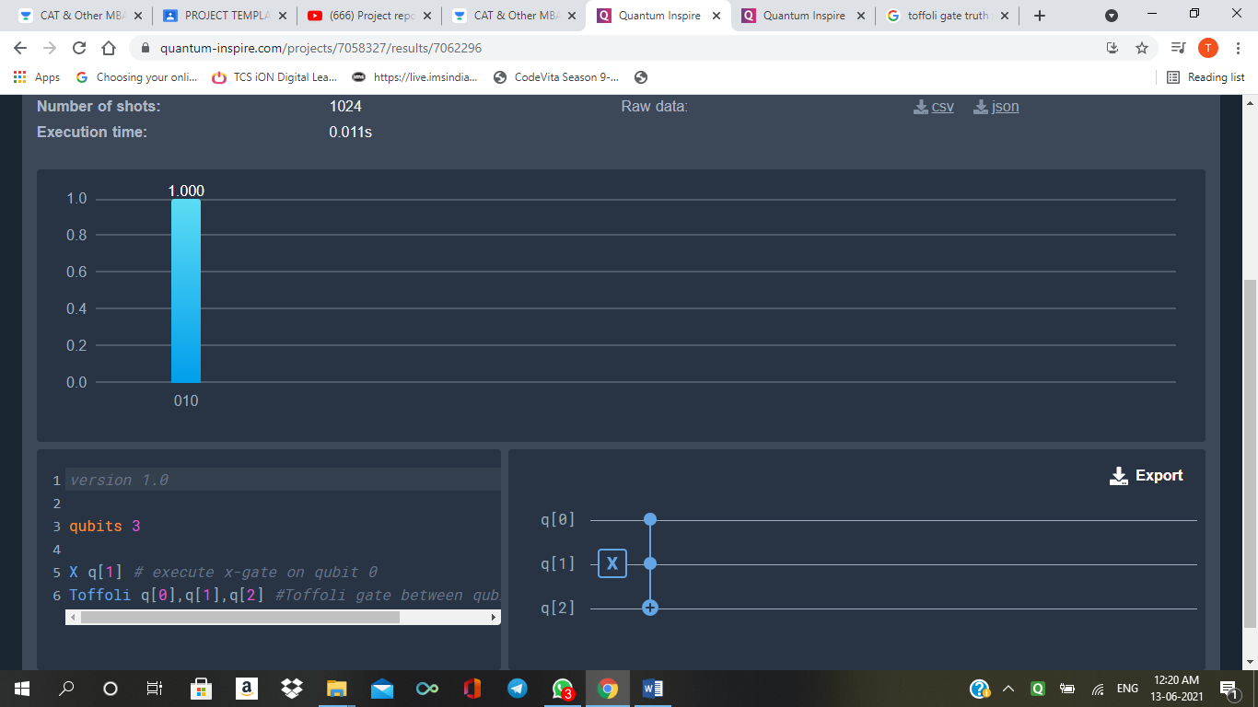
TOFFOLI GATE
The Toffoli gate is similar to the CNOT gate, but has three input signals, two of which “decide” about the output of the last input.
Here, the bottom signal flips only if both the top two inputs are equal to 1.

Slide 13
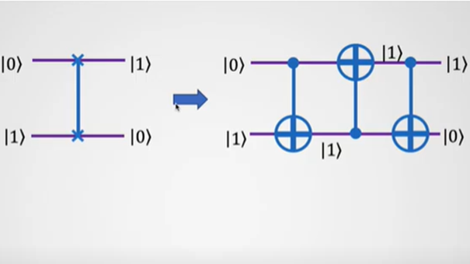
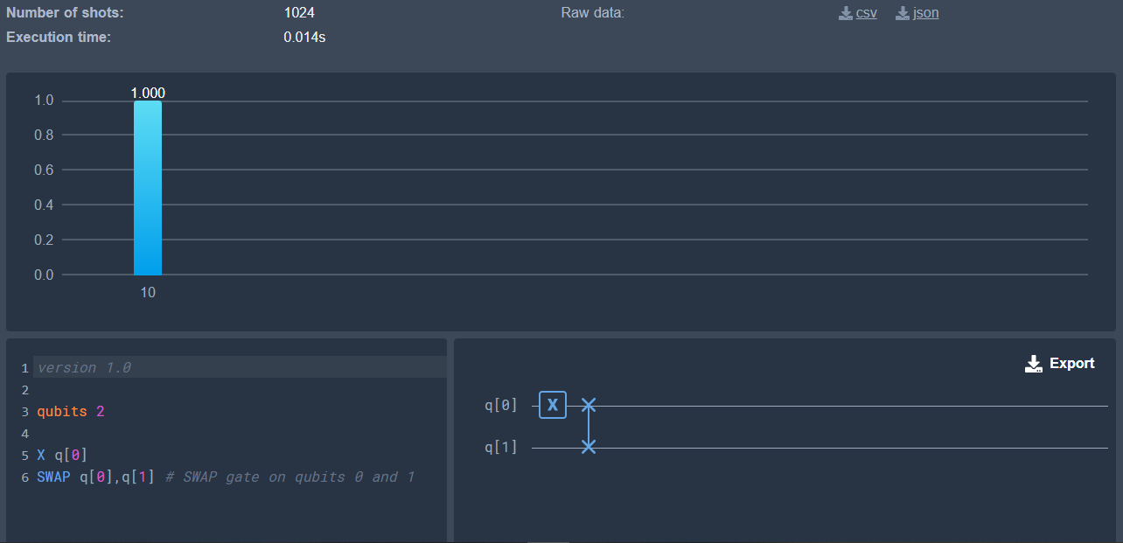
SWAP GATE
There is no control unit in this gate.
If inputs are |0⟩ and |1⟩ then after swapping the result becomes ket |1⟩ and ket |0⟩ .

Slide 14
FAULT TOLERANCE
Fault Tolerance alludes to the ability of a system to continue operating without interruption when one or more of its components fail.
It aims to ensure high-availability of the system by preventing disruptions arising from a single point of failure.
There are two fault-tolerant approaches:
fault-removal – This can be either forward error recovery or backward error recovery.
fault-masking – When the presence of one defect hides the presence of another defect in the system.
Fault tolerance is necessary for systems that are used to protect people’s safety such as air traffic control hardware and software systems and in systems that security, data protection, data integrity, and high-value transactions all depend on.

Slide 15
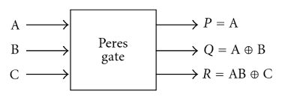
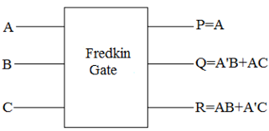
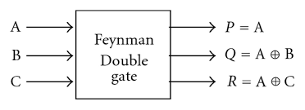
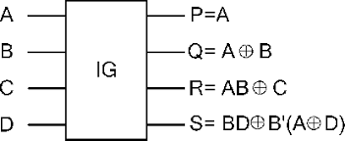
FAULT TOLERANT GATES
Peres Gate
Fredkin Gate
Feynman Double Gate
IG

Slide 16
A | B | C | D | P | Q | R | S
0 | 0 | 0 | 0 | 0 | 0 | 0 | 0
0 | 0 | 0 | 1 | 0 | 0 | 0 | 1
0 | 0 | 1 | 0 | 0 | 0 | 1 | 0
0 | 0 | 1 | 1 | 0 | 0 | 1 | 1
0 | 1 | 0 | 0 | 0 | 1 | 0 | 0
0 | 1 | 0 | 1 | 0 | 1 | 0 | 1
0 | 1 | 1 | 0 | 0 | 1 | 1 | 0
0 | 1 | 1 | 1 | 0 | 1 | 1 | 1
1 | 0 | 0 | 0 | 1 | 1 | 0 | 1
1 | 0 | 0 | 1 | 1 | 1 | 0 | 0
1 | 0 | 1 | 0 | 1 | 1 | 1 | 1
1 | 0 | 1 | 1 | 1 | 1 | 1 | 0
1 | 1 | 0 | 0 | 1 | 0 | 1 | 0
1 | 1 | 0 | 1 | 1 | 0 | 1 | 1
1 | 1 | 1 | 0 | 1 | 0 | 0 | 0
1 | 1 | 1 | 1 | 1 | 0 | 0 | 1
ISLAM GATE (IG)
Islam Gate is a 4*4 parity preserving
reversible gate. The gate is one through, which means one of the input variables is also output.
The corresponding truth table of the gate is shown. It can be verified from the truth table that the input pattern corresponding to particular output pattern can be uniquely determined.
The newly proposed IG gate is universal in the sense that it can be used for implementing any arbitrary Boolean function.

Slide 17
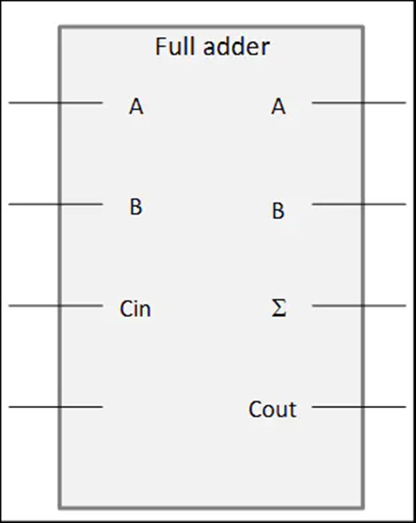
FULL ADDER CIRCUIT USING REVERSIBLE GATES
A reversible logic gate is a memory-less logic element that realizes an injective logical function. In simple words Reversible gates are the one which give us the same number of outputs and the inputs. Not gate is the only reversible gate in Classical computing whereas in Quantum Computing all the gate are reversible.
ADVANTAGE: Implementing the reversible logic has the
advantages of reducing gate counts, garbage outputs as
well as constant inputs.
For building a full adder circuit we have used 3 reversible
gates which are:
-Toffoli Gate or CCNot Gate
- CNot gate or Controlled Note Gate
- Pauli’s-X Gate

Slide 18
FULL ADDER TRUTH TABLE
q3 | q2 | q1 | q0 |  | q3 | q2 | q1 | q0
- | Ci | B | A |  | Co | S | B | A
0 | 0 | 0 | 0 |  | 0 | 0 | 0 | 0
0 | 1 | 0 | 0 |  | 0 | 1 | 0 | 0
0 | 0 | 1 | 0 |  | 0 | 1 | 1 | 0
0 | 1 | 1 | 0 |  | 1 | 0 | 1 | 0
0 | 0 | 0 | 1 |  | 0 | 1 | 0 | 1
0 | 1 | 0 | 1 |  | 1 | 0 | 0 | 1
0 | 0 | 1 | 1 |  | 1 | 0 | 1 | 1
0 | 1 | 1 | 1 |  | 1 | 1 | 1 | 1
I/P: q0=A, q1=B, q2= CarryIn O/P:q0=A,q1=B,q2=Sout,q3=Carryout

Slide 19

SOFTWARE REQUIREMENT
Software used : QUANTUM INSPIRE
Developed by: QuTech
Quantum Inspire is a prototype full-stack quantum computer. It serves as a training and education platform, a test-bed for application development and as an invitation for co-development and collaborative R&D of quantum computers.
Few Programmable quantum processors are: 1) SPIN-2: 2) STARMON-5
3) QX-26 and QX-31
4) QX Single-Node Simulator (used in project)

Slide 20
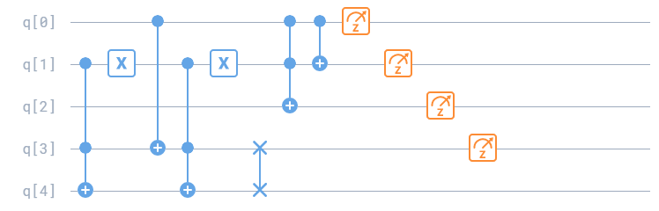
QUANTUM EQUIVALENT OF IG GATE

Slide 21
PROPOSED FAULT TOLERANT FULL ADDER CIRCUIT
A
IG
IG
G2
A + B
B
Cin
S=A + B + Cin
A B
0
Cout= (A +B)Cin +AB
0
G1
G3
The proposed block diagram is built using minimum number of garbage outputs and constant inputs required to design a fault tolerant reversible full adder circuit. It is a newly proposed parity preserving 4*4 reversible gate IG and that is efficient than the existing designs.
Fault tolerant reversible full adder circuit is realized using 3 Garbage outputs and 2 constant inputs.
The output equations for full adder are:
(I) S=A ⊕ B ⊕ Cin ; (II) Cout= (A ⊕ B) Cin + AB

Slide 22
PROPOSED WORK Vs EXISTING WORK
 | NO. OF GATES | NO. OF CYCLES | NO. OF GARBAGE OUTPUTS | NO. OF CONSTANT INPUT | TOTAL LOGICAL CALCULATION
Existing work Design of a novel fault tolerant reversible Montgomery multiplier in nanotechnology | 2FRGs+ 4F2G=6 | 6 | 6 | 5 | 12α+8β+2γ
Proposed Study | 2IGs=2 | 2 | 3 | 2 | 8α+6β+2γ

Slide 23
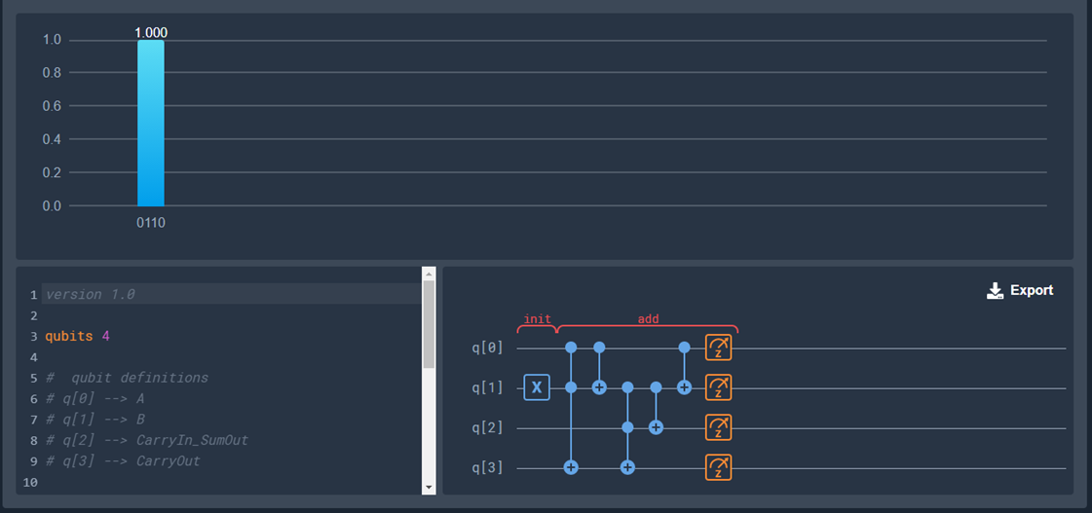
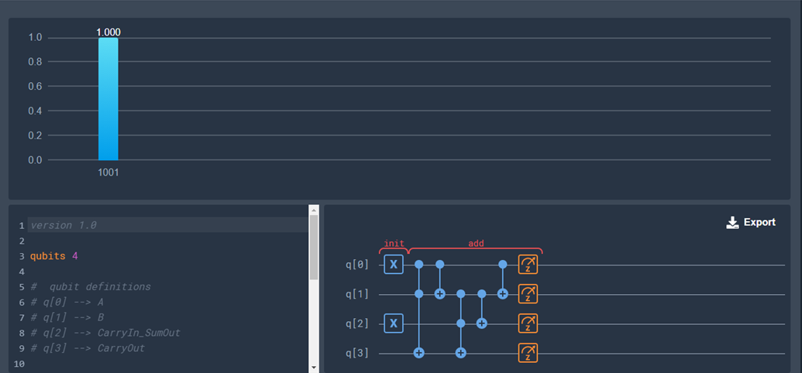
IMPLEMENTATION: QUANTUM INSPIRE
I/P: 0010 (-,Ci, B, A) O/P: 0110 (Co, S, B, A)
I/P: 0101(-,Ci, B, A) O/P: 1001(CO, S, B, A)

Slide 24
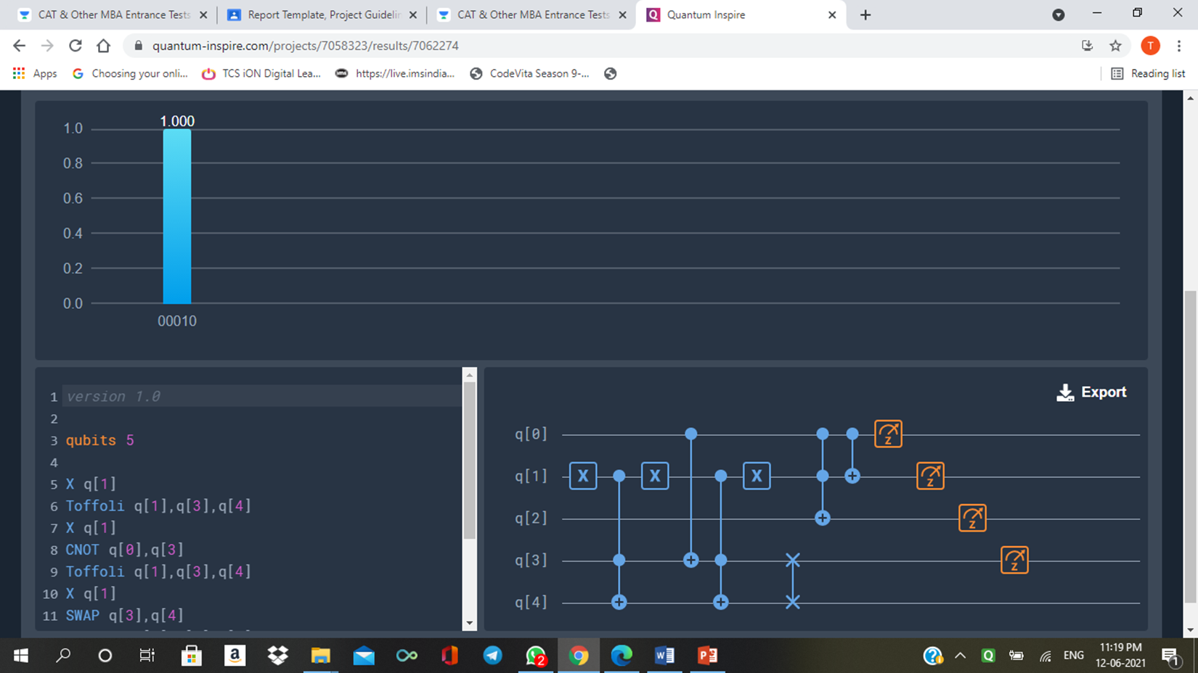
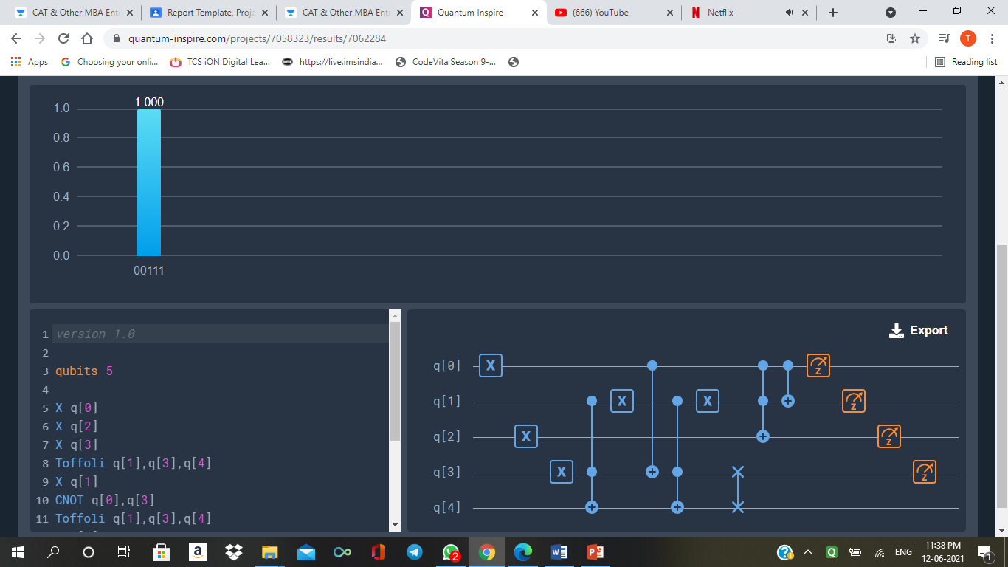
IG IMPLEMENTATION : QUANTUM INSPIRE
I/P: 0100 (A,B,C,D) O/P:0100 (P,Q,R,S)
I/P: 1011 (A,B,C,D) O/P: 1110 (CO,S,A,B)

Slide 25
CONCLUSION
As far as innovation we are developing past old style registering into another information time called quantum computing. The quantum computing force and speed will assist us with tackling the greatest and most complex difficulties we face as people. We proposed a 4*4 parity preserving logic gate named Islam Gate in which parity of the input matches the parity of the output, a fault tolerant reversible gate full adder circuit will be realized using 2 IGs. With the help of Quantum Inspire we tried building up a full adder circuit using the above said gates. This proposed full adder circuit generates very less garbage output and has low quantum cost if compared to the existing systems.

Slide 26
Advantages & Applications
Advantages:
Increased processing power
Fault tolerance
Security
Energy efficiency
Application:
Quantum Error Correction
Cryptography
Quantum Simulation

Slide 27
Future Scope
In the context of technology, some examples of future-scope technologies include artificial intelligence, quantum computing, biotechnology, nanotechnology, and renewable energy. These technologies have the potential to transform various industries and improve our lives in numerous ways.
As for the platform for exploring and sharing ideas, Future scope could refer to conferences, forums, or online communities focused on emerging technologies and their potential impact. These platforms provide a space for experts and enthusiasts to discuss new ideas, share insights, and collaborate on innovative solutions.

Slide 28


